Slide 1
OPTICAL INTERCONNECTS

Slide 2
OPTICAL INTERCONNECTS
Digital signal-processing and computing systems contain large numbers of interconnected gates, switches, and memory elements.
In electronic systems the interconnections are made by use of conducting wires, coaxial cables, or conducting channels within semiconductor integrated circuits.
Photonic interconnections may similarly be realized by use of optical waveguides with integrated-optic or fiber-optic couplers.
Free-space light beams may also be used for interconnections, wherein beams are directed by micro lenses or diffractive optical elements.
This option is not available in electronic systems since electron beams must be in vacuum and cannot cross one another without mutual repulsion.

Slide 3
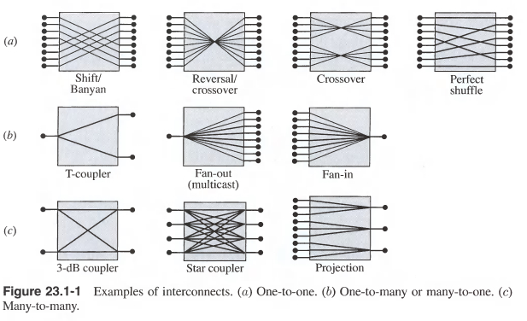
OPTICAL INTERCONNECTS
Examples of Interconnects:
Fig. illustrates a number of configurations of interconnects (also called couplers).
Each input port is connected to one or many output ports, and vice-versa.
For example, in the fan-out or the T-coupler configuration, the input port is connected to each of the output ports.
In the star coupler or the directional coupler, each input port is connected to each and every output port.

Slide 4
OPTICAL INTERCONNECTS
Key performance specifications of practical couplers include the following power ratios, usually expressed in dB [= -10 log(1/ratio)]:
• The insertion loss describes the port-to-port power transmittance, ideally 0 dB for a lossless path.
For a coupler distributing power among multiple output ports, the splitting ratio is the ratio of the power at one output port to the power at all output ports.
For example, for an ideal 3-dB coupler, the splitting ratio is 3 dB.
The crosstalk is the ratio of the undesired power received at an output port to the input power directed to another output port(s).
The excess loss is the ratio of the total output power to the total input power.

Slide 5
Nonreciprocal Interconnects: Isolators and Circulators

Slide 6
Nonreciprocal Interconnects: Isolators and Circulators
The designation of the ports of an interconnect as input or output ports implies a specific direction of transmission - from input to output (from left to right in the examples in Fig.).
Certain interconnects are reciprocal, i.e., if the transmission is directed instead from the output ports to the input ports, the interconnection matrix remains the same.
Otherwise, the interconnect is nonreciprocal.

Slide 7
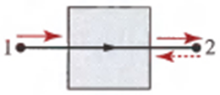
Isolators:
The simplest example of nonreciprocal interconnects is a 1 x 1 unidirectional link that transmits in only one direction, as illustrated in Fig.
2-port unidirectional link (isolator).
This is often implemented by use of an optical isolator, much like a diode or a one-way valve.
The performance of an isolator is specified by the insertion loss [(power transmittance in the forward direction (dB)] and the reverse isolation [(power transmittance in the reverse direction (dB)].

Slide 8



Multiport Nonreciprocal Interconnects
The input/output designation is not applicable when a port plays a dual role, as transmitter and receiver.
The interconnect is then designated simply by the number of ports.
Fig. (b) and (c) are example of 3- port interconnects using unidirectional links.
These interconnects are used in duplex (two-way) communication systems, as depicted in the 4-port interconnect in Fig.(e).
In another 4-port system, shown in Fig. (d), the connections between the left and right ports are in the parallel configuration in the forward direction (left to right), and in the cross configuration in the backward direction (right to left).

Slide 9
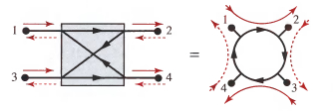
Circulators
Another example of nonreciprocal interconnects is the optical circulator.
This is an interconnect with three or more ports connected by unidirectional links pointing in the same direction.
As illustrated in Fig. the 4-port circulator is equivalent to the interconnect in Fig. d.
4 – port circulator
Circulators find many applications in communication systems and networks.
An example of the use of circulators in optical add-drop multiplexers (OADM).

Slide 10
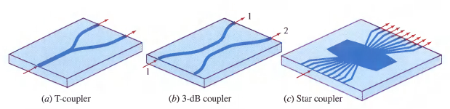
Guided Wave Interconnects
Optical interconnects are implemented in planar light wave circuits (PLCs) by patterning optical waveguides in LiNbO₃ or silicon substrates much like metal wires in electronic printed circuits or integrated circuits.
Examples are illustrated in Fig. and combinations and cascades of these basic interconnects can be used to create more complex interconnects.

Slide 11

Waveguide couplers are used to distribute optical power in prescribed amounts.
The coupler shown in Fig. b is described by an interconnection matrix
Where C is the coupling coefficient and L is the interaction length.
The incoming power in input port 1 is therefore divided among output ports 1 and 2 by factors cos²CL and sin²CL, respectively.
For CL = π/4, the power is divided equally and the coupler becomes a 3-dB coupler.

Slide 12
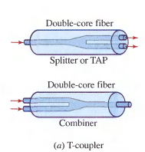
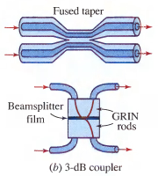
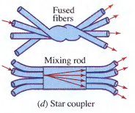

Applications of optical fiber technology, particularly in telecommunication, have stimulated the development of many fiber-optic interconnects.
Examples:
Fan-in or fan-out.
Star coupler using fused fibres and another using a mixing rod, a slab of glass through which light
from one fiber is dispersed to reach all other fibers.
3-dB coupler made of two fused fibres and another using two GRIN-rod lenses separated by a beamsplitter film
Double-core fiber used as a T-coupler, splitter, or combiner.

Slide 13
PHOTONIC SWITCHES

Slide 14
PHOTONIC SWITCHES
Architectures of Space Switches
A switch is a device that establishes and releases connections among transmission paths in a communication or signal-processing system.
A control unit processes the commands for connections and sends a control signal to operate the switch in the desired manner.
While interconnects always operate on the incoming signals in the same manner, switches are controllable, active, or reconfigurable interconnects that are modified by an external command.

Slide 15
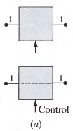
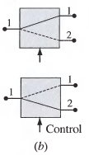
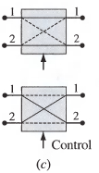
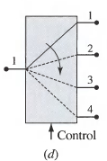
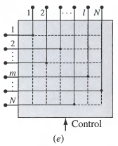
Examples of switches are shown in Fig.
1 x 1 switch connects or disconnects two lines. It is an ON - OFF switch.
1 x 2 switch connects one line to either of two lines.
2 x 2 crossbar switch connects two lines to lines. It has two configurations: the bar state and the cross state, and may be regarded as a controllable directional coupler.
1 x N switch connects one line to one of N lines.
N x N crossbar switch connects N lines to N lines.
Any input line can always be connected to a free (unconnected) output line without blocking (i.e., without conflict).

Slide 16
A 1 x 1 switch can be used as an elementary unit from which switches of larger sizes can be built.
An N x N cross point-matrix (crossbar) switch may be constructed by using an array of N² 1 x 1 switches organized at the points of an N x N matrix to connect or disconnect each of the N input lines to a free output line.
The m^{th} input reaches all elementary switches of the m^{th} row, while the lth output is connected to outputs of all elementary switches of the l^{th} column.
A connection is made between the m^{th} input and the Ith output by activating the (m, l) 1 x 1 switch.

Slide 17
Switch Characteristics
A switch is characterized by the following parameters:
Size - number of input and output lines and direction(s), i.e., whether data can be transferred in one or two directions.
Switching time - time necessary for the switch to be reconfigured .
Propagation delay time - time taken by the signal to cross the switch.
Throughput - maximum data rate that can flow through the switch .
Switching energy - energy needed to activate and deactivate the switch.
Power dissipation - energy dissipated per second in the process of switching.
Insertion loss - drop in signal power introduced by the connection.
Crosstalk - undesired power leakage to other lines.
Blocking probability - Probability that a connection cannot be established because of a conflict with another connection.
Physical dimensions - This is important when large arrays of switches are built.

Slide 18
Electro-Optic Switches
Electro-optic materials alter their refractive indexes in the presence of an electric field.
They may be used as electrically controlled phase modulators or wave retarders.
When placed in one arm of an interferometer, or between two crossed polarizers, the electro-optic cell serves as an electrically controlled light modulator or a 1 x 1 (on - off) switch.
Since it is difficult to make large arrays of switches using bulk crystals, the most promising technology for electro-optic switching is integrated optics.
Integrated-optic waveguides are fabricated using electro-optic dielectric substrates, such as lithium niobate LiNbO₃, with strips of slightly higher refractive index at the locations of the waveguides, created by diffusing titanium into the substrate.

Slide 19
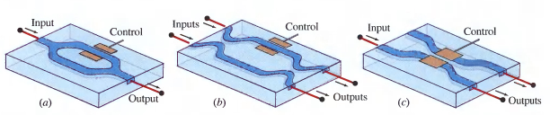
Example
(a) A 1 x 1 switch using an integrated-optic Mach - Zehnder interferometer. (b) A 2 x 2 switch using an integrated-optic Mach - Zehnder interferometer. (c) A 2 x 2 switch using an integrated-optic directional coupler.
Two waveguides in close proximity are optically coupled; the refractive index is altered by applying an electric field adjusted so that the optical power either remains in the same waveguide or is transferred to the other waveguide.
These switches operate at a few volts with speeds that can exceed 20 GHz.

Slide 20
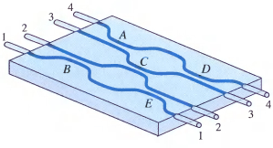
An N x N integrated-optic switch can be built by use of a combination of 2 x 2 switches.
A 4 x 4 switch is implemented by use of five 2 x 2 switches connected as in Fig. This configuration can be fabricated on a single substrate.
Fig: An integrated-optical 4 x 4 switch using five directional couplers A, B, C, D, and E on a single substrate.
Lithium niobate electro-optic switches of size up to 32 x 32 have been fabricated.

Slide 21
Limitations
The limit on the number of switches per unit area is governed by the relatively large physical dimensions of each directional coupler and the planar nature of the interconnections within the chip.
To reduce the dimensions and increase the packing density of switches, intersecting (instead of parallel) waveguides are used.
Because of the rectangular nature of integrated-optics technology, it is difficult to obtain efficient coupling to cylindrical waveguides (e.g., optical fibers).
Relatively large insertion losses are encountered, especially when a single-mode fiber is connected to an integrated-optic switch.
Because the coupling coefficient is polarization dependent, the polarization of the guided light must be properly selected.
This imposes a restriction requiring that the input and output connecting fibers must be polarization maintaining.

Slide 22
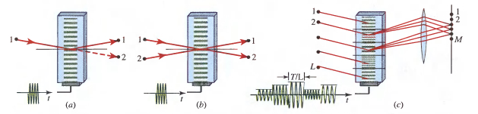
Acousto-Optic Switches
Acousto-optic switches use the property of Bragg deflection of light by sound.
The power of the deflected light is controlled by the intensity of the sound. The angle of deflection is controlled by the frequency of the sound.
An acousto-optic modulator is a 1 x 1 switch. An acousto-optic scanner is a 1 x N switch, where N is the number of resolvable spots of the scanner. Acousto-optic cells with N = 2000 are available.
If different parts of the acousto-optic cell carry sound waves of different frequencies, an N x M switch or interconnection device is obtained.
Fig. Acousto-optic switches. (a) 1 x 2 ON - OFF switch, (b) 2 x 2 directional coupler, (c) L x M cross-bar switch.

Slide 23
Nonlinear Mach – Zehnder Interferometer Switch
A Mach – Zehnder Interferometer (MZI) with a nonlinear optical element in one of its branches may be used as an all – optical 1 × 2 switch directing an optical beam at one of its two input ports to either of its output ports.
The switch is controlled by an optical beam illuminating the nonlinear element. In the absence of the control beam, the interferometer is balanced such that the input light is directed to one of the output ports.
When the control beam is applied, it induces a change in the refractive index Δn, which in turns creates an incremental phase shift of π so that the input beam is directed to the other output port.
The interferometer may be implemented using bulk optics or fiber optics.
This 1 x 2 switch may be used as a 1 x 1 ON - OFF switch by simply ignoring one of the output ports.

Slide 24
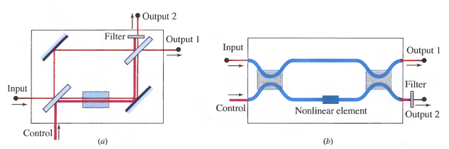
(a) An all-optical 1 x 2 switch using a Mach-Zehnder interferometer with an optical Kerr cell. (b) A fiber-optic Mach-Zehnder interferometer.

Slide 25
OPTICAL GATES
Highly sophisticated digital electronic systems (e.g., a digital computer) contain a large number of interconnected basic units: switches, gates, and memory elements (flip-flops).
Bistable Systems
A bistable (or two-state) system has an output that can take only one of two distinct stable values, no matter what input is applied.
Switching between these values may be achieved by a temporary change of the level of the input.

Slide 26
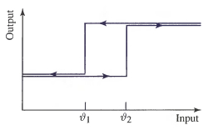
Ex:
Logic: The output takes its low value for small inputs and its high value for large inputs.
When an increasing input exceeds a certain critical value (threshold) ϑ2, the output jumps from the low to the high value.
When the input is subsequently decreased, the output jumps back to the lower value when another critical value ϑ₁ < ϑ₂ is crossed, so that the input—output relation forms a hysteresis loop.
Fig: Input – output hysteresis relation for a bistable system

Slide 27
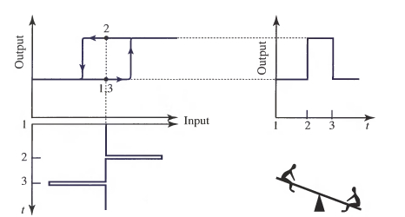
There is an intermediate range of input values (between ϑ₁ and ϑ₂ ) for which low or high outputs are possible, depending on the history of the input. Within this range, the system acts like a seesaw.
If the output is low, a large positive input spike flips it to high. A large negative input spike flips it back to low. The system has a "flip-flop" behaviour; its state depends on its history' (whether the last spike was positive or negative).
Flip-flopping of a bistable system.
At time 1 the output is low.
A positive input pulse at time 2 flips the system from low to high.
The output remains in the high state until a negative pulse at time 3 flips it back to the low state.
The system acts as a latching switch or a memory element.

Slide 28
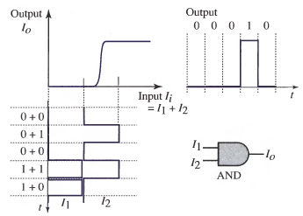
Bistable devices as logic elements
Bistable devices are also used as logic elements. The binary data are represented by pulses that are added and their sum used as input to the bistable device.
With an appropriate choice of the pulse heights in relation to the threshold, the device can be made to switch to high only when both pulses are present, so that it acts as an AND gate.
The AND logic gate is a digital device with two binary inputs and one binary output. Both inputs must be in the “1" state for the output to be in the "1" state. Otherwise, the output is in the “0” state.
Logic gates may be used as switches.
Ex: By using one of the inputs to an AND gate, as the control, the gate becomes 1 x 1 ON - OFF switch.
The bistable device as an AND logic gate. The input I_{i} = I₁+I₂, where I₁ and I₂ are pulses representing the binary data. The output I_{O} is high if and only if both inputs are present.

Slide 29
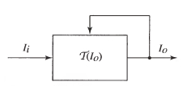

Principle of Optical Bistability
Two features are required for making a bistable device: nonlinearity and feedback.
An electronic bistable (flip-flop) circuit is made by connecting the output of each of two transistors to the input of the other. An optical bistable system is realized by use of a nonlinear optical element whose output beam is used in a feedback system to control the transmission of light through the element itself.
By means of feedback the output intensity I_{O} is somehow made to control the transmittance T of the system, so that 'T’ is some nonlinear function T = T (I_{O}). Since I_{O}=T(I_{i}).
The generic optical system is given in.
An optical system whose transmittance T is a function of its output IO.
Input – Output relation for a bistable system.

